Slide 1
WiFiMon Probes for Digital Generations
MSc. Elisantila Gaci, RASH
WiFiMon Service Owner
TNC23/Tirana, Albania
June 2023

Slide 2
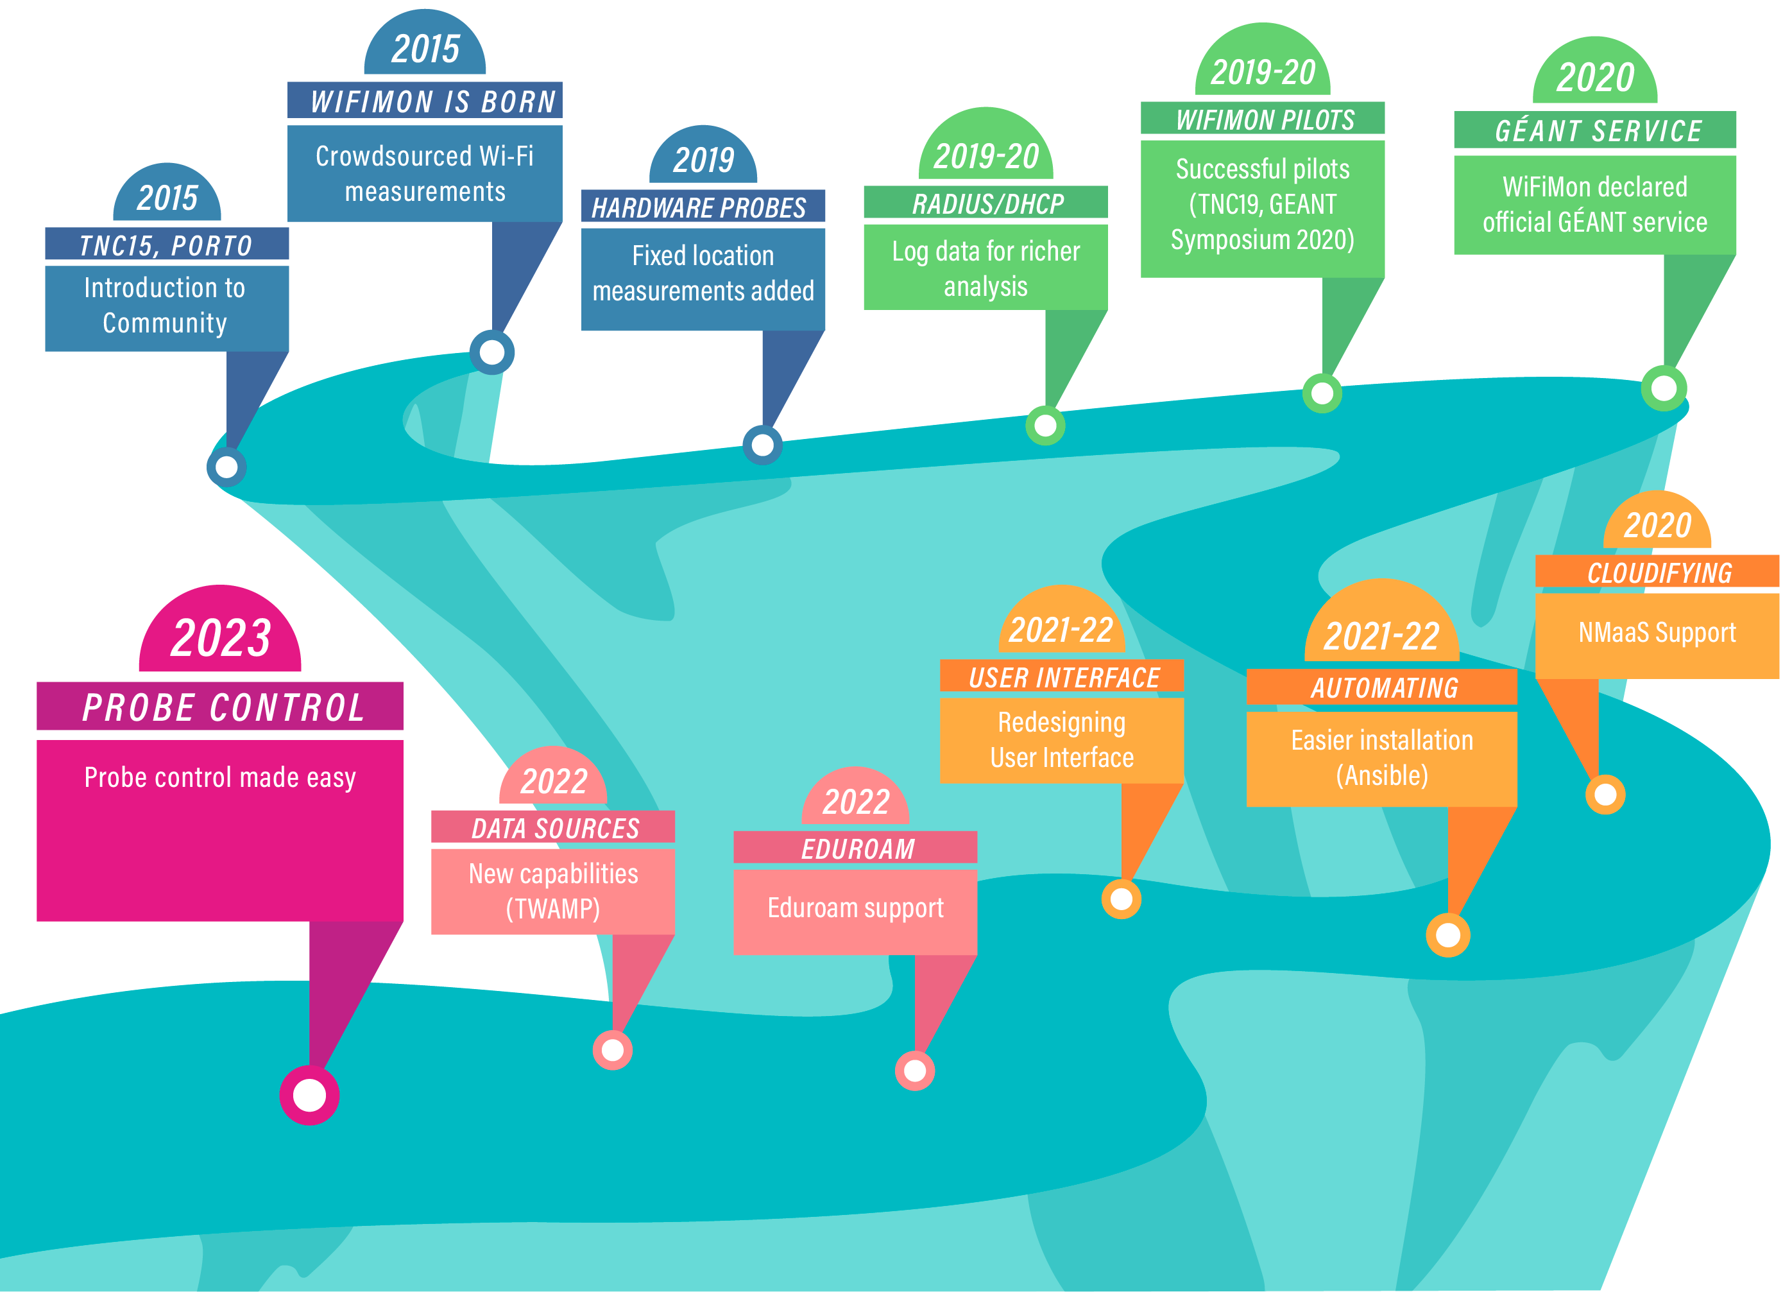
Notes:
2015 and the idea of WiFiMon is born: Monitoring the performance of Wi-Fi networks as experienced by their end users without requiring their intervention, presented
to the community at TNC15, Porto. End-user crowdsourced measurements are complemented by
hardware probes that monitor Wi-Fi performance from fixed network positions, whereas data from RADIUS and DHCP logs are used to report performance per network Access Point, thus enabling the detection of underperforming Wi-Fi segments. WiFiMon capabilities will be subsequently challenged by monitoring the conference venues of prominent GÉANT meetings. WiFiMon pilots in TNC19 and GÉANT Symposium 2020 delivered promising results and led to the declaration of WiFiMon as an official GÉANT service. To offer better services, WiFiMon is integrated with NMaaS to cloudify some of its components, automating wifimon installation. Additional steps are also followed: WiFiMon becomes more appealing and user friendly by redesigning its User Interface, support for eduroam monitoring is provided, whereas WiFiMon monitoring capabilities are
enriched by incorporating popular network monitoring solutions and standardized protocols, e.g., TWAMP. WiFiMon team is currently trying to simplify probe configuration and control; automation tools are employed to configure probes from a centralized location, while reducing administrator effort.

Slide 3
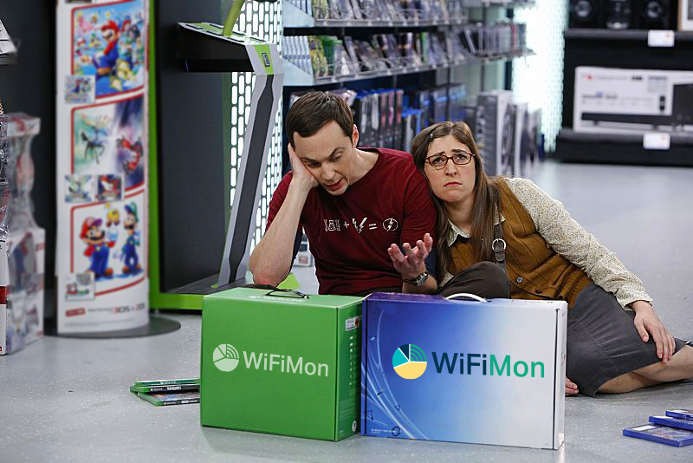
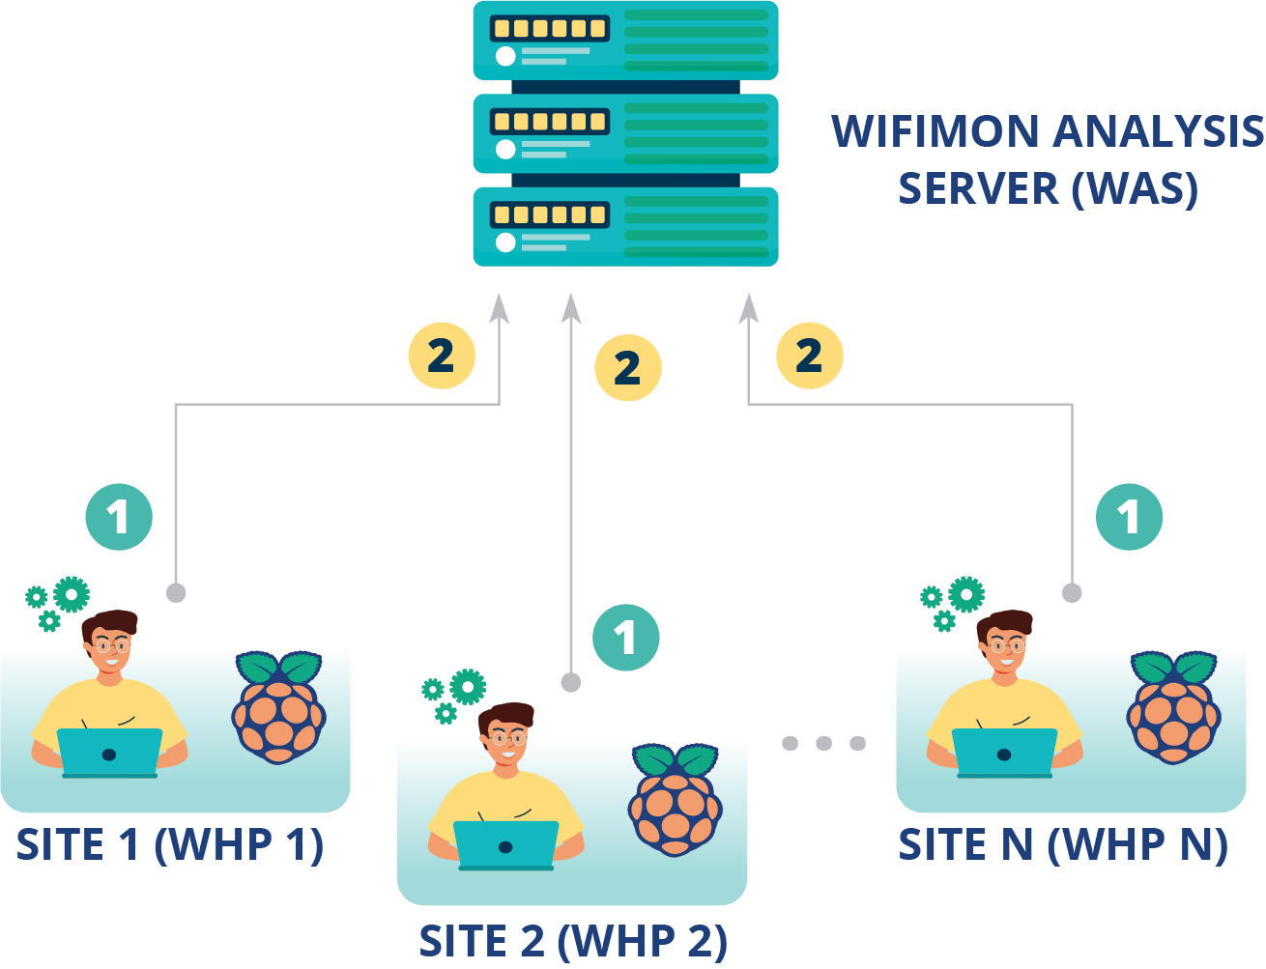
WHP Configuration & Control
Old approach
Administrator feedback demonstrated limitations:
In NAT networks
In public networks
Administrators edit config directly

Slide 4

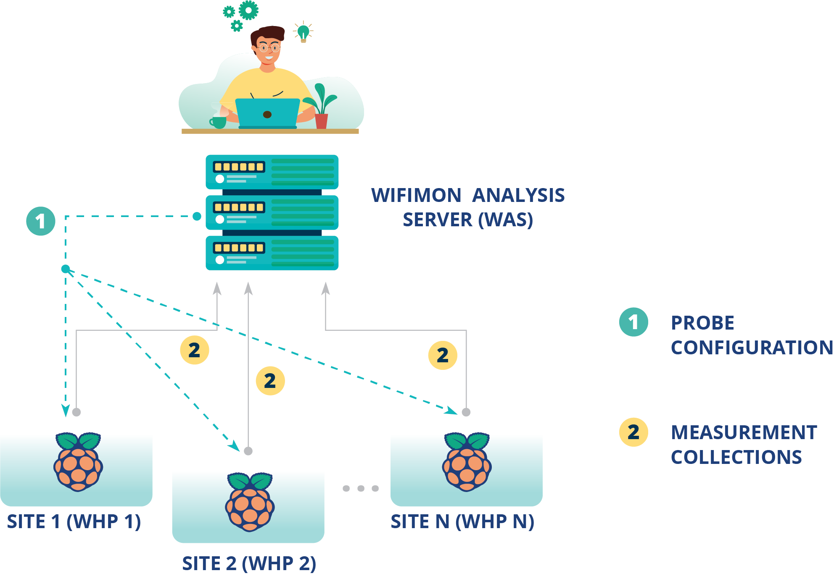
Novel approach required!!!
Remote & user-friendly configuration of WHP’s from a central point (WAS)
Ability to control WHP’s behind NAT networks

Slide 5
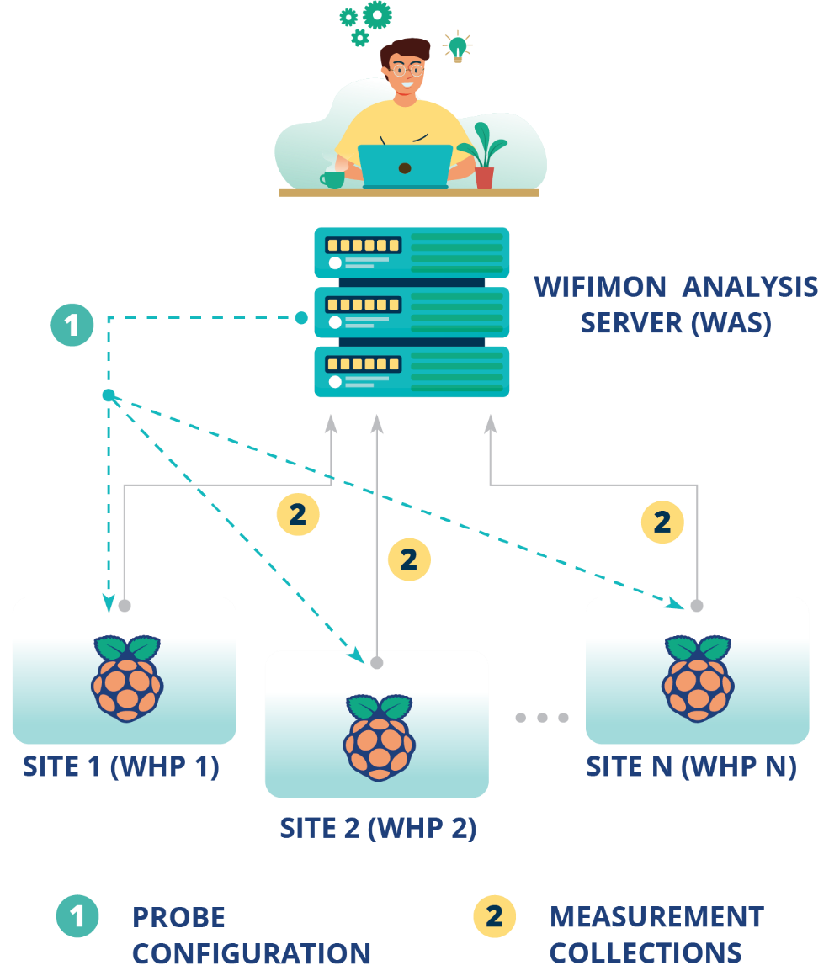
Novel approach required!!!
Old approach

Slide 6
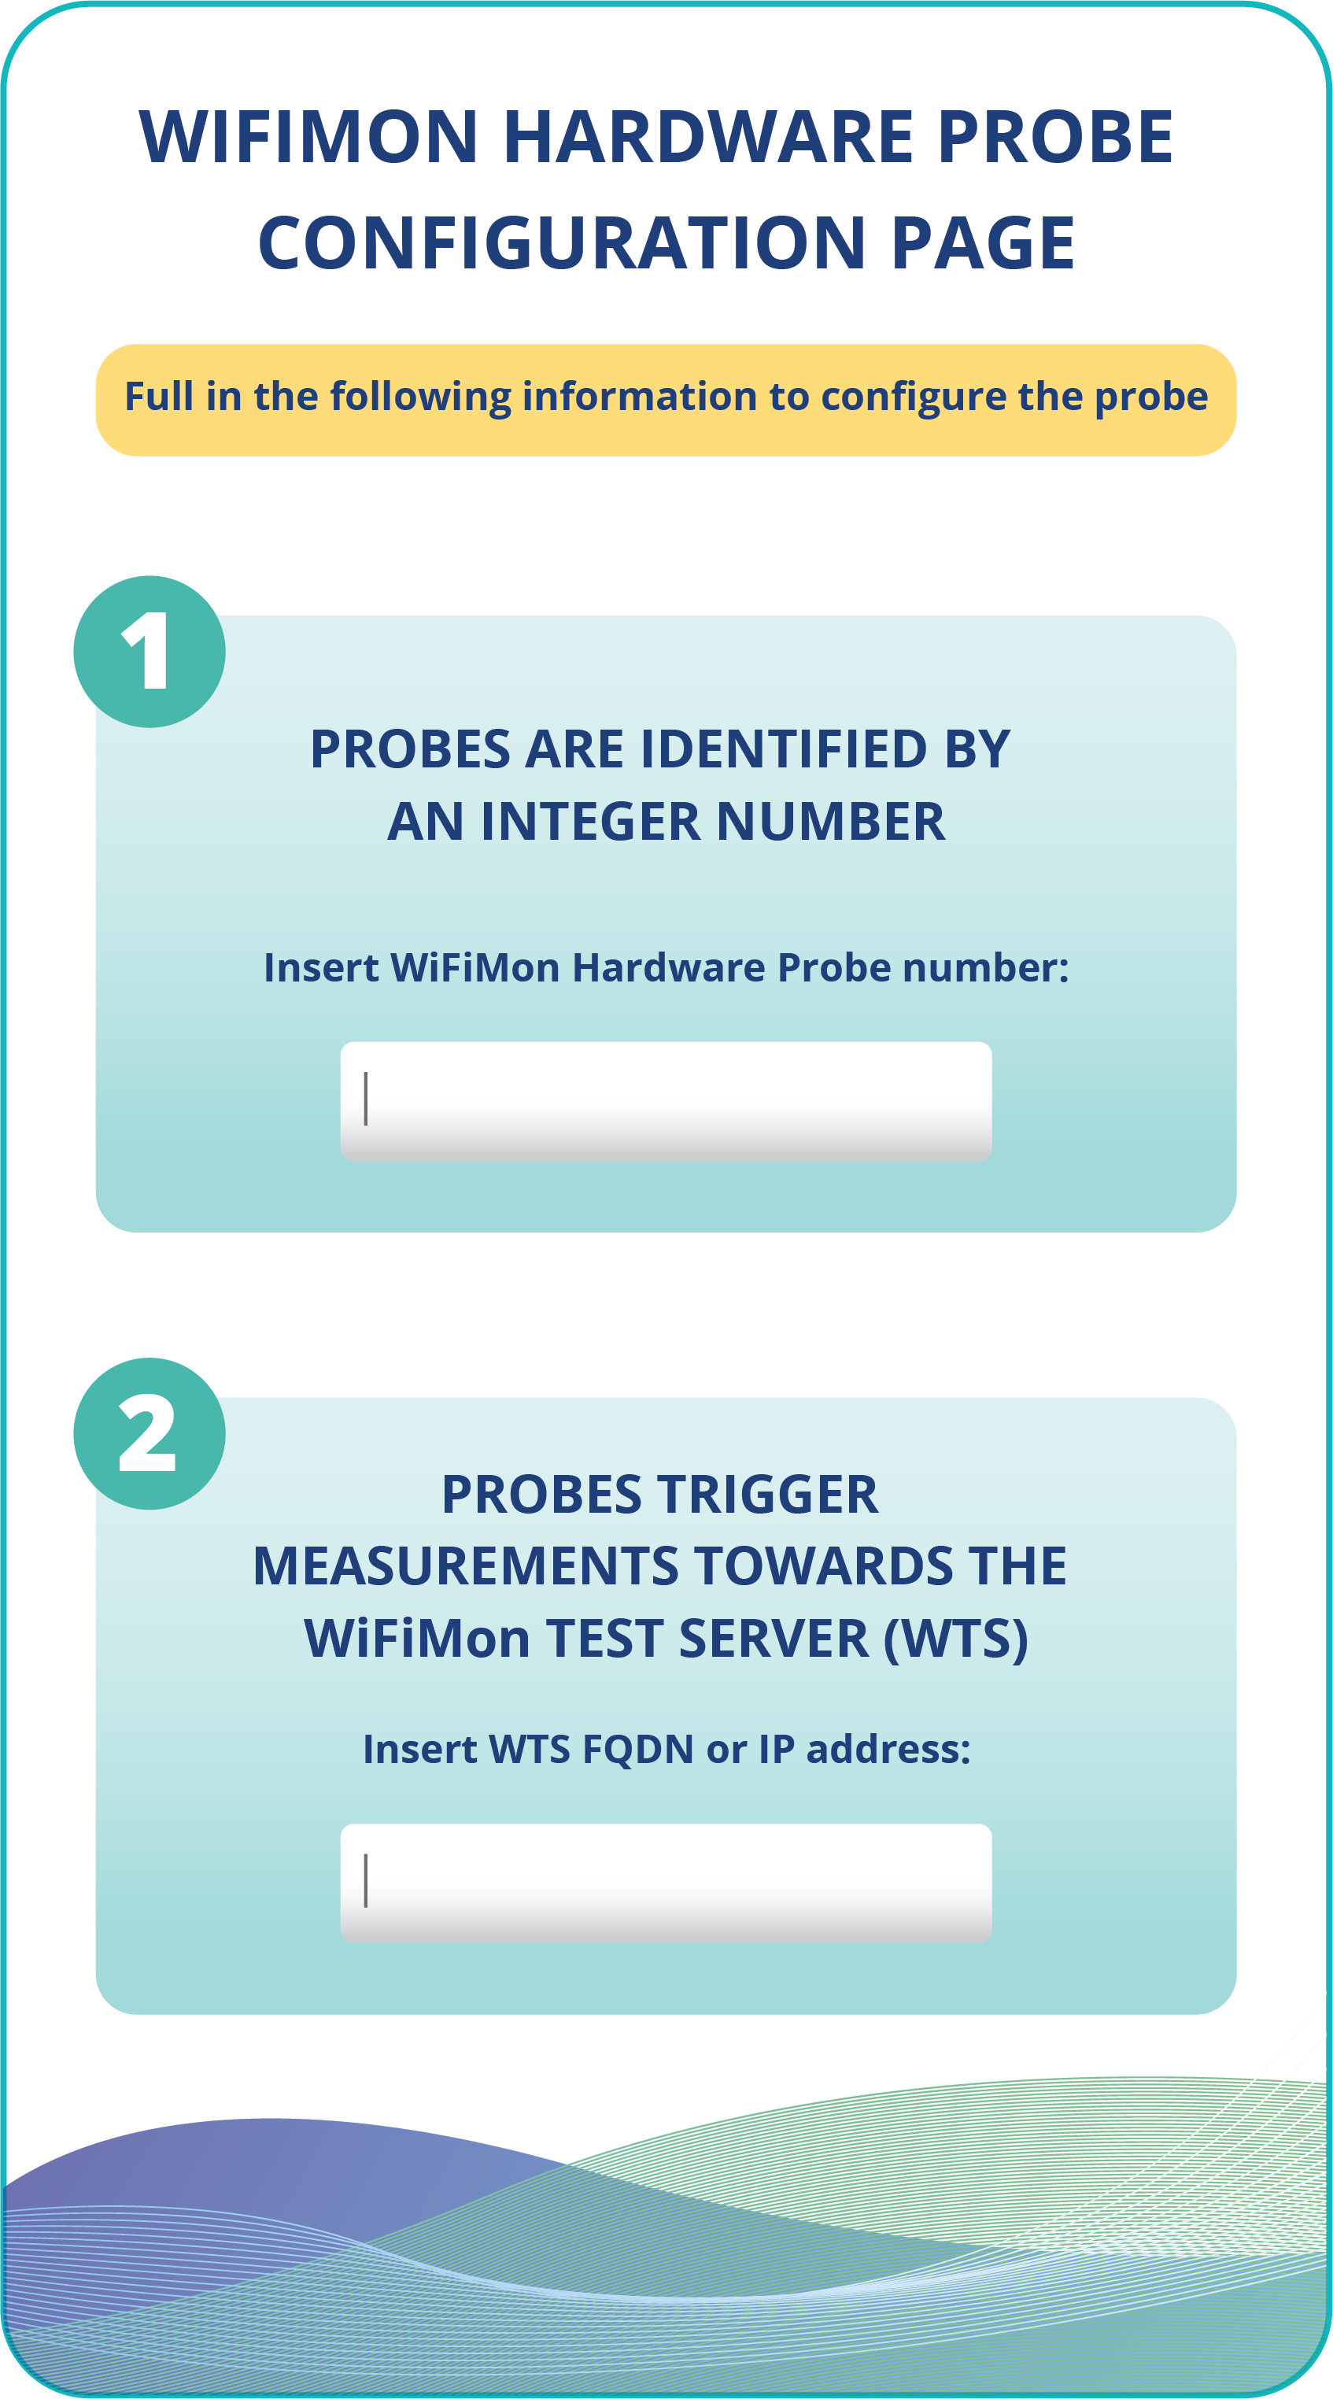

WHP Configuration Made easy
Administrators (re)configure WHP’s from the WiFiMon UI

Slide 7

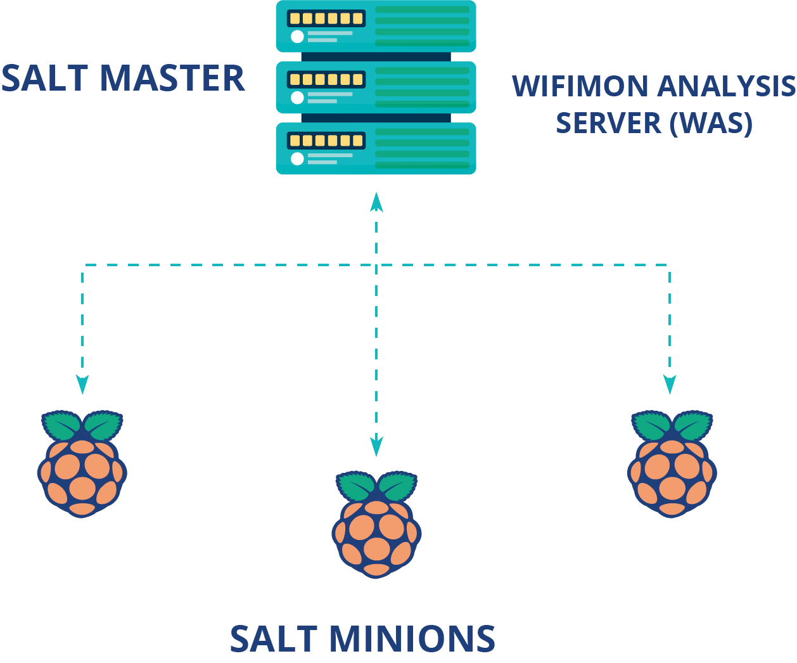
Remote WHP Configuration Made Possible
Solution based on the Salt infrastructure management tool
WiFiMon Analysis Server → Salt Master
WiFiMon Hardware Probes → Salt Minions

Slide 8

Remote WHP Configuration Made Possible
Salt establishes application layer communication: - WHP’s are remotely configured from the WAS
Remote reconfiguration possible even for WHP’s behind NAT
Public IP addresses are not required → IP space is consumed
1
Salt includes a ZeroMQ message broker: Parallel configuration regardless of the WHP number
2
Configuration files generated from templates are transferred from the WAS to the respective probes
3

Slide 9
Thank You

